Slide 1
Tangent Planes and Linear Approximations
Scott Surgent

Slide 2
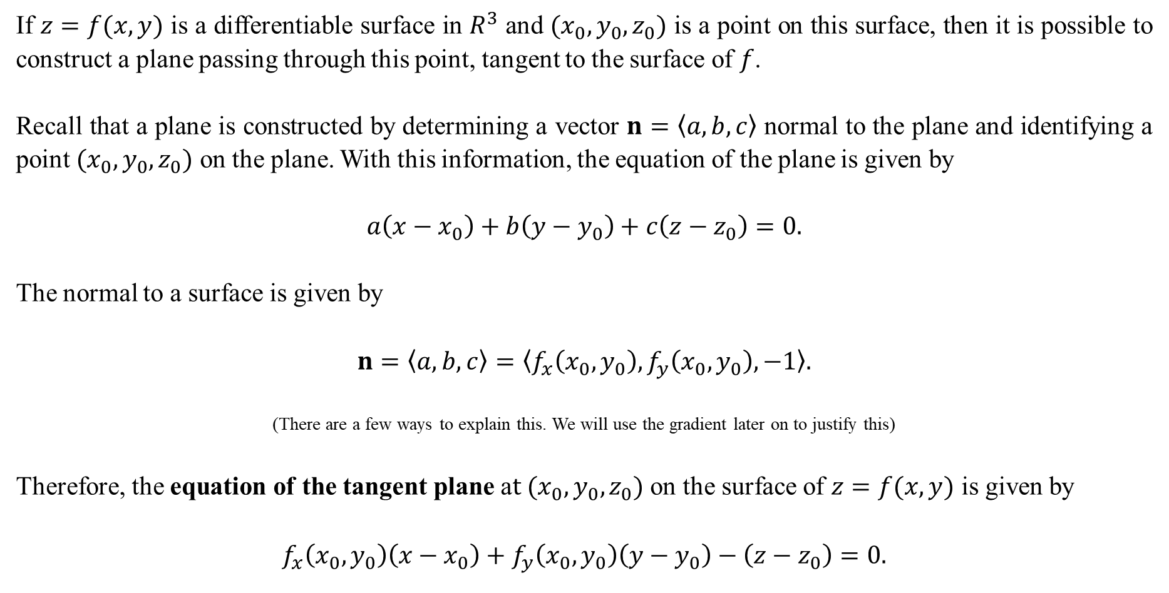
If $z=f(x,y)$ is a differentiable surface in $R^{3}$ and $(x_{0},y_{0},z_{0})$ is a point on this surface, then it is possible to construct a plane passing through this point, tangent to the surface of $f$.
Recall that a plane is constructed by determining a vector $n=〈a,b,c〉$ normal to the plane and identifying a point $(x_{0},y_{0},z_{0})$ on the plane. With this information, the equation of the plane is given by
$$a\left(x−x_{0}\right)+b\left(y−y_{0}\right)+c\left(z−z_{0}\right)=0.$$
The normal to a surface is given by
$$n=〈a,b,c〉=〈f_{x}\left(x_{0},y_{0}\right),f_{y}\left(x_{0},y_{0}\right),−1〉.$$
(There are a few ways to explain this. We will use the gradient later on to justify this)
Therefore, the equation of the tangent plane a$t (x_{0},y_{0},z_{0})$ on the surface of $z=f(x,y)$ is given by
$$f_{x}\left(x_{0},y_{0}\right)\left(x−x_{0}\right)+f_{y}\left(x_{0},y_{0}\right)\left(y−y_{0}\right)−\left(z−z_{0}\right)=0.$$

Slide 3
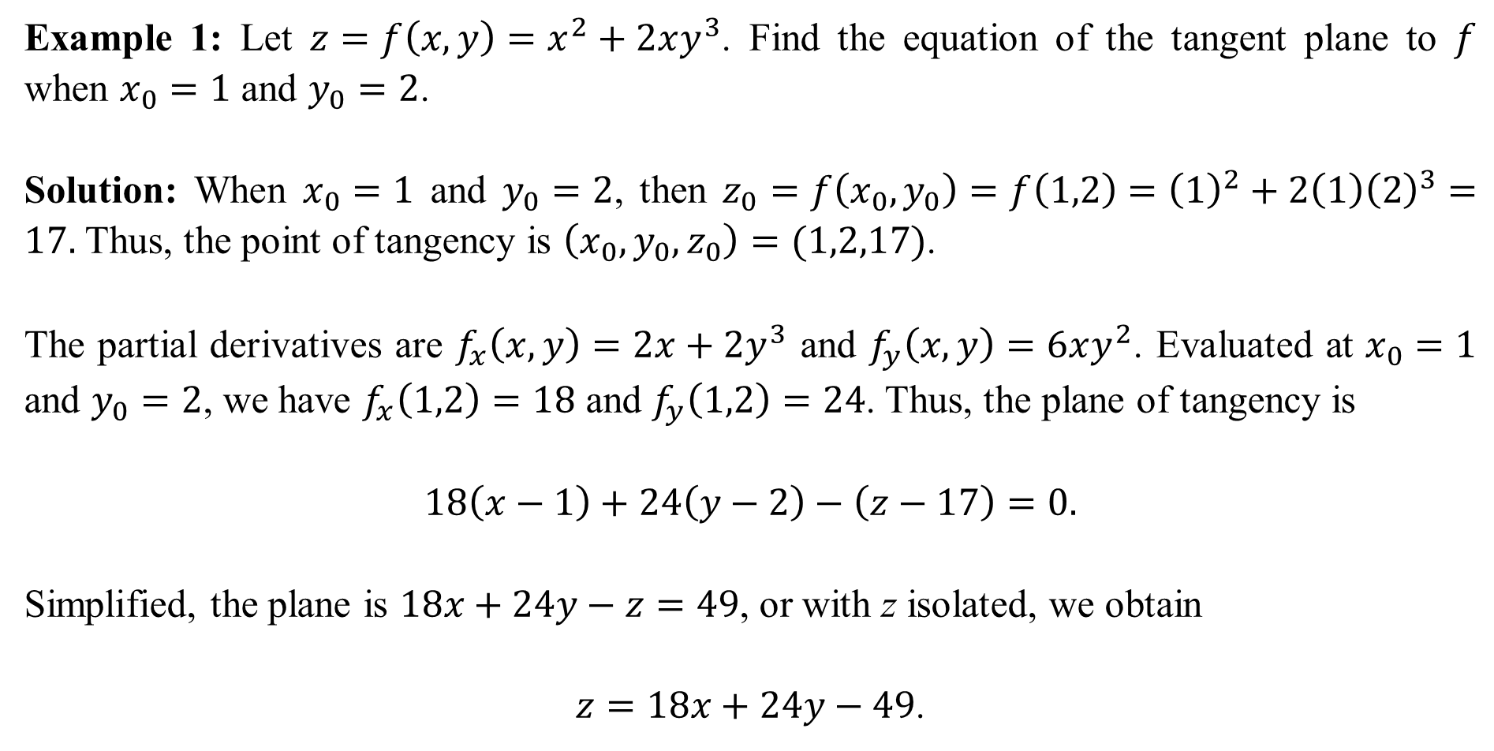
Example 1: Let $z=f\left(x,y\right)=x^{2}+2xy^{3}$. Find the equation of the tangent plane to $f$ when $x_{0}=1$ and $y_{0}=2$.
Solution: When $x_{0}=1$ and $y_{0}=2$, then $z_{0}=f\left(x_{0},y_{0}\right)=f\left(1,2\right)={\left(1\right)}^{2}+2\left(1\right){\left(2\right)}^{3}=17.$ Thus, the point of tangency is $\left(x_{0},y_{0},z_{0}\right)=(1,2,17)$.
The partial derivatives are $f_{x}\left(x,y\right)=2x+2y^{3}$ and $f_{y}\left(x,y\right)=6xy^{2}$. Evaluated at $x_{0}=1$ and $y_{0}=2$, we have $f_{x}\left(1,2\right)=18$ and $f_{y}\left(1,2\right)=24$. Thus, the plane of tangency is
$$18\left(x−1\right)+24\left(y−2\right)−\left(z−17\right)=0.$$
Simplified, the plane is $18x+24y−z=49$, or with z isolated, we obtain
$z=18x+24y−49$.

Slide 4
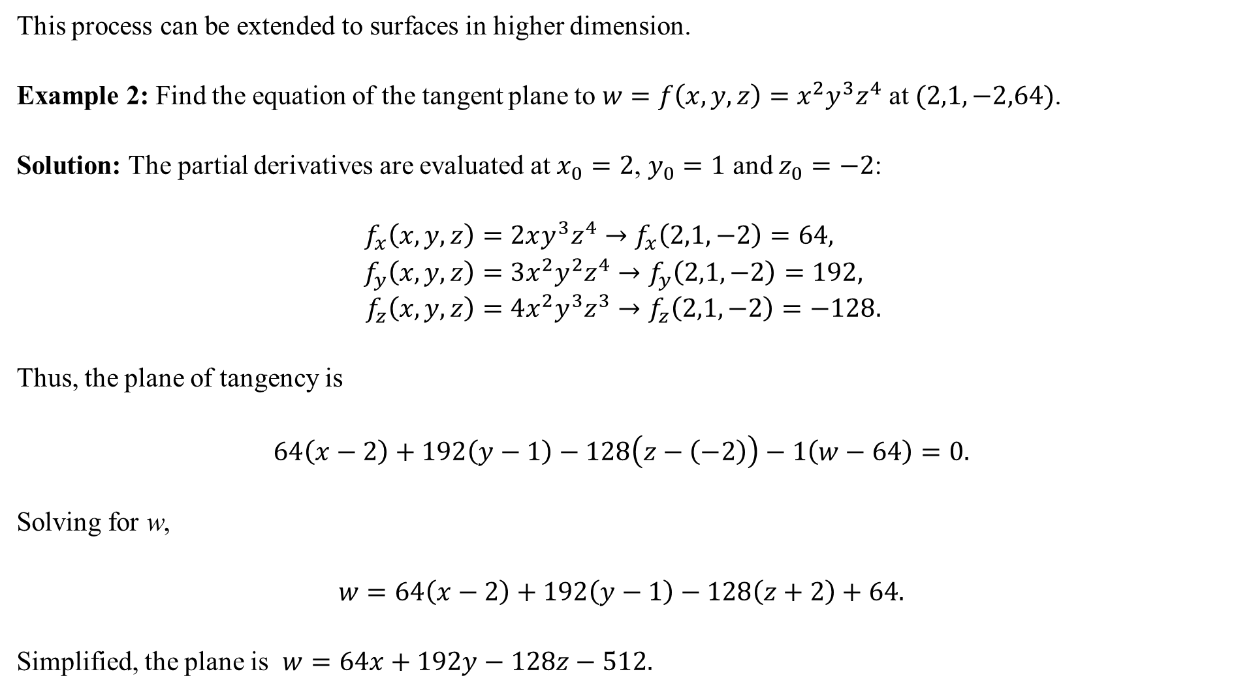
This process can be extended to surfaces in higher dimension.
Example 2: Find the equation of the tangent plane to $w=f\left(x,y,z\right)=x^{2}y^{3}z^{4}$ at $(2,1,−2,64)$.
Solution: The partial derivatives are evaluated at $x_{0}=2$, $y_{0}=1$ and $z_{0}=−2$:
$$f_{x}\left(x,y,z\right)=2xy^{3}z^{4}→f_{x}\left(2,1,−2\right)=64, \\ f_{y}\left(x,y,z\right)=3x^{2}y^{2}z^{4}→f_{y}\left(2,1,−2\right)=192, \\ f_{z}\left(x,y,z\right)=4x^{2}y^{3}z^{3}→f_{z}\left(2,1,−2\right)=−128.$$
Thus, the plane of tangency is
$$64\left(x−2\right)+192\left(y−1\right)−128\left(z−\left(−2\right)\right)−1\left(w−64\right)=0.$$
Solving for w,
$$w=64\left(x−2\right)+192\left(y−1\right)−128\left(z+2\right)+64.$$
Simplified, the plane is $w=64x+192y−128z−512.$

Slide 5
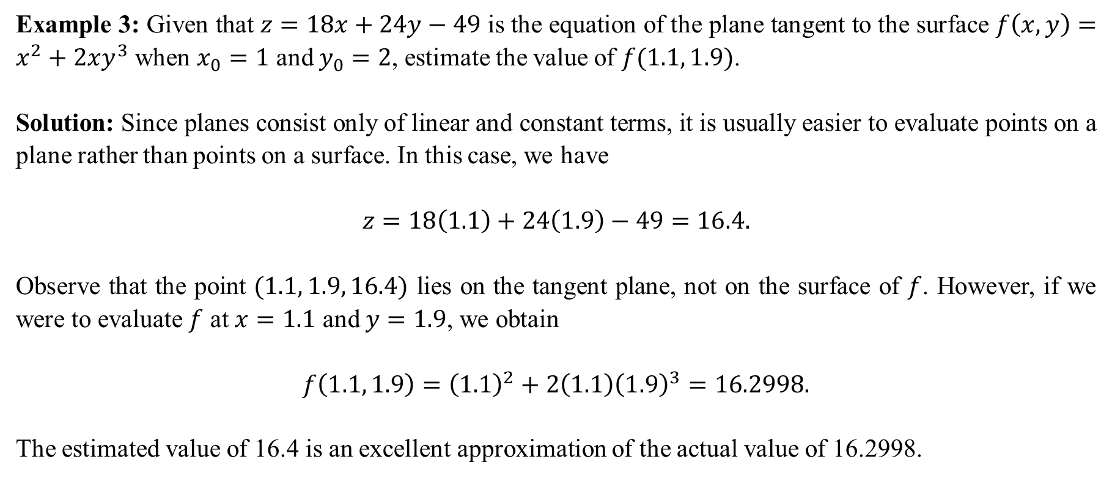
Example 3: Given that $z=18x+24y−49$ is the equation of the plane tangent to the surface $f\left(x,y\right)=x^{2}+2xy^{3}$ when $x_{0}=1$ and $y_{0}=2$, estimate the value of $f(1.1, 1.9)$.
Solution: Since planes consist only of linear and constant terms, it is usually easier to evaluate points on a plane rather than points on a surface. In this case, we have
$$z=18\left(1.1\right)+24\left(1.9\right)−49=16.4.$$
Observe that the point $(1.1, 1.9, 16.4)$ lies on the tangent plane, not on the surface of $f$. However, if we were to evaluate $f$ at $x=1.1$ and $y=1.9$, we obtain
$$f\left(1.1, 1.9\right)={\left(1.1\right)}^{2}+2\left(1.1\right){\left(1.9\right)}^{3}=16.2998.$$
The estimated value of 16.4 is an excellent approximation of the actual value of 16.2998.

Slide 6
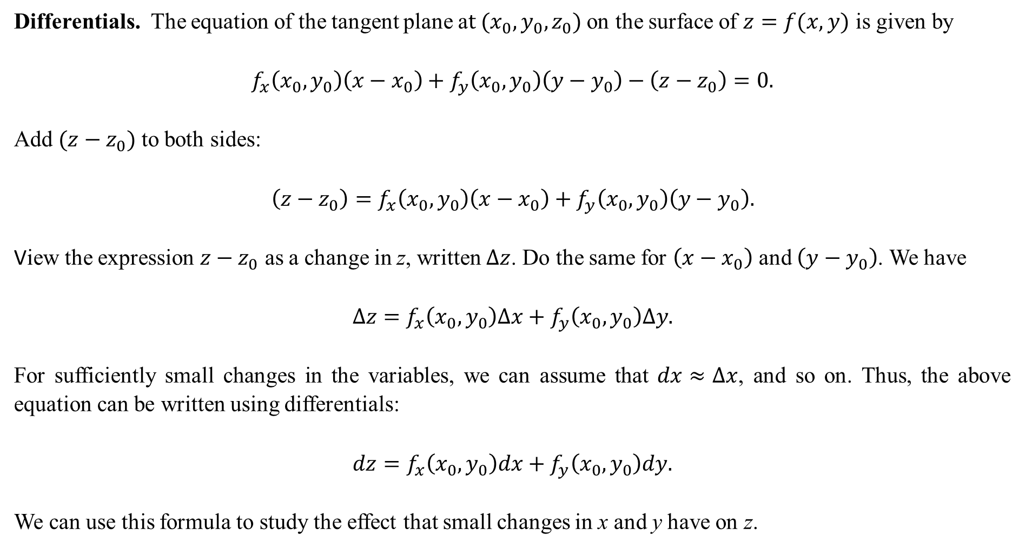
Differentials. The equation of the tangent plane a$t (x_{0},y_{0},z_{0})$ on the surface of $z=f(x,y)$ is given by
$$f_{x}\left(x_{0},y_{0}\right)\left(x−x_{0}\right)+f_{y}\left(x_{0},y_{0}\right)\left(y−y_{0}\right)−\left(z−z_{0}\right)=0.$$
Add $(z−z_{0})$ to both sides:
$$\left(z−z_{0}\right)=f_{x}\left(x_{0},y_{0}\right)\left(x−x_{0}\right)+f_{y}\left(x_{0},y_{0}\right)\left(y−y_{0}\right).$$
View the expression $z−z_{0}$ as a change in z, written $∆z$. Do the same for $\left(x−x_{0}\right)$ and $\left(y−y_{0}\right)$. We have
$$∆z=f_{x}\left(x_{0},y_{0}\right)∆x+f_{y}\left(x_{0},y_{0}\right)∆y.$$
For sufficiently small changes in the variables, we can assume that $dx≈∆x$, and so on. Thus, the above equation can be written using differentials:
$$dz=f_{x}\left(x_{0},y_{0}\right)dx+f_{y}\left(x_{0},y_{0}\right)dy.$$
We can use this formula to study the effect that small changes in x and y have on z.

Slide 7
Example 4: The exterior of a circular cylindrical tank is measured to be 4 meters in radius and 5 meters high. Assume that the measurements have a tolerance of $0.02$ meters for the radius and $0.03$ meters for the height. What effect do the possible variances in radius or height have on the volume of the tank?
Solution: The volume is given by $V\left(r,h\right)=πr^{2}h$, where r is the radius of the base, and h is the vertical height. The differentials $dV$, $dr$ and $dh$ are related by the formula
$$dV=V_{r}\left(r_{0},h_{0}\right)dr+V_{h}\left(r_{0},h_{0}\right)dh. \\ =2πr_{0}h_{0} dr+πr_{0}^{2} dh \\ =2π\left(4\right)\left(5\right)\left(0.02\right)+π{\left(4\right)}^{2}(0.03) \\ =40π\left(0.02\right)+16π\left(0.03\right). \\ =4.02 cubic meters.$$
It might be surprising that being off by just 0.02 meters (2 cm) when measuring the radius and 0.03 meters (3 cm) when measuring the height would translate into a change of approximately 4 cubic meters for the volume.

Slide 8
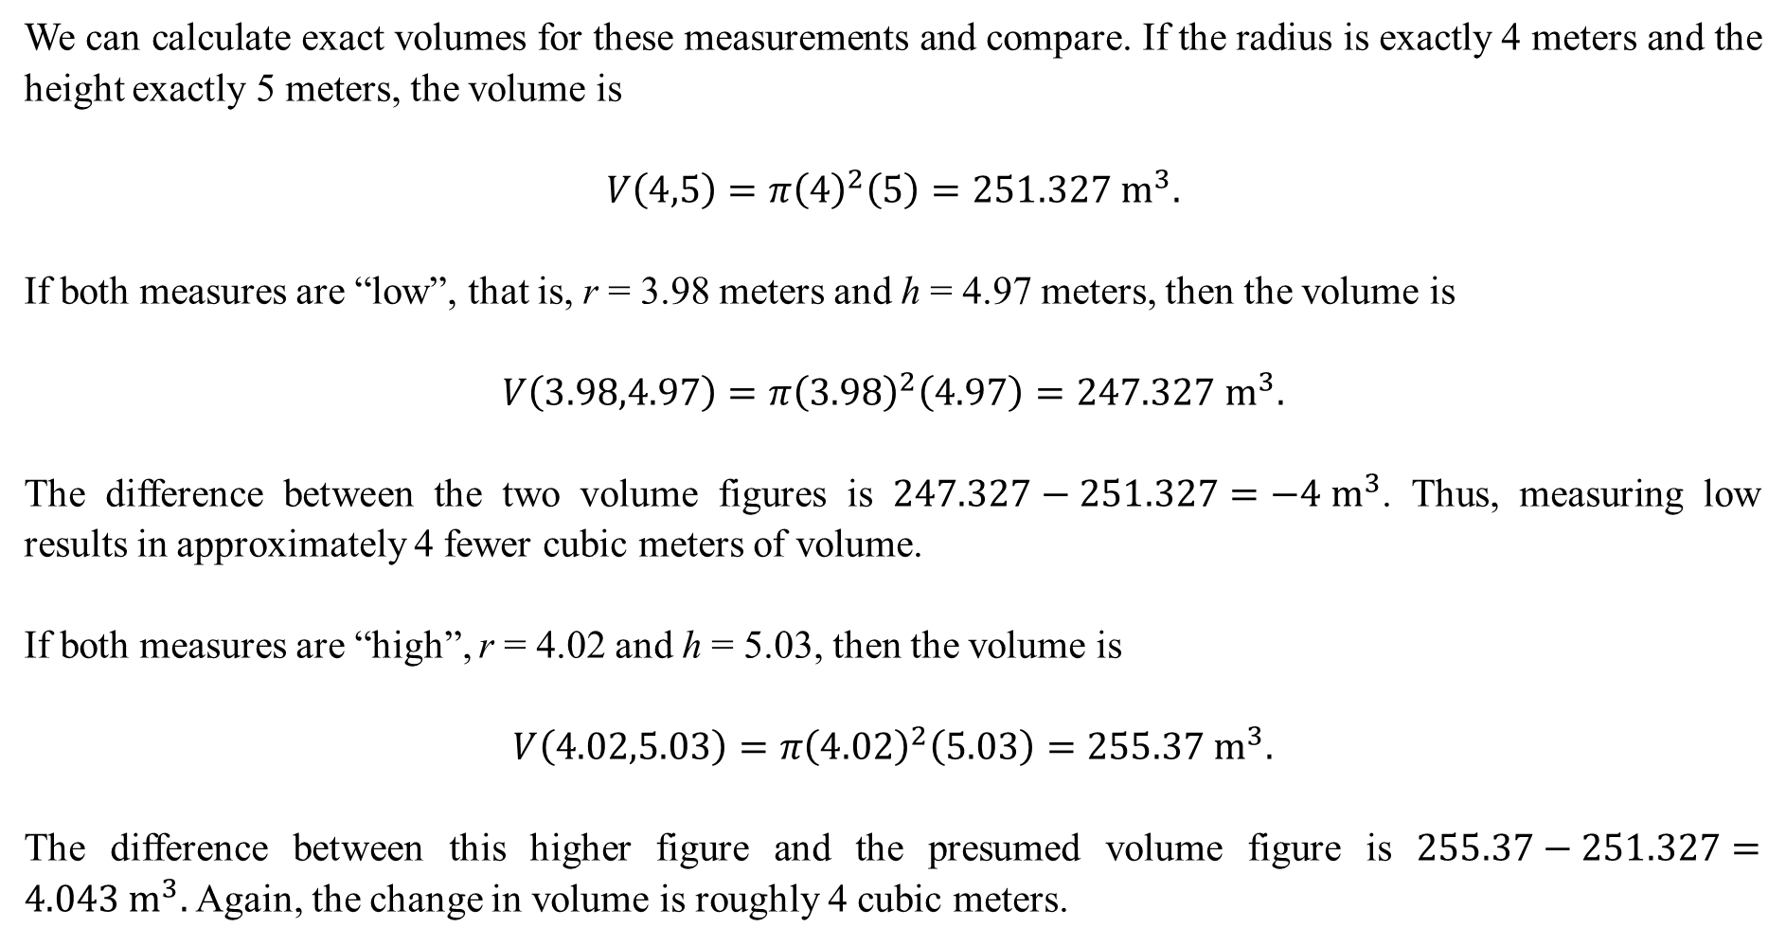
We can calculate exact volumes for these measurements and compare. If the radius is exactly 4 meters and the height exactly 5 meters, the volume is
$$V\left(4,5\right)=π{\left(4\right)}^{2}\left(5\right)=251.327 m^{3}.$$
If both measures are “low”, that is, r = 3.98 meters and h = 4.97 meters, then the volume is
$$V\left(3.98,4.97\right)=π{\left(3.98\right)}^{2}\left(4.97\right)=247.327 m^{3}.$$
The difference between the two volume figures is $247.327−251.327=−4 m^{3}$. Thus, measuring low results in approximately 4 fewer cubic meters of volume.
If both measures are “high”, r = 4.02 and h = 5.03, then the volume is
$$V\left(4.02,5.03\right)=π{\left(4.02\right)}^{2}\left(5.03\right)=255.37 m^{3}.$$
The difference between this higher figure and the presumed volume figure is $255.37−251.327=4.043 m^{3}.$ Again, the change in volume is roughly 4 cubic meters.

Slide 9
Example 5: The surface area of a rectangular box of length l, width w and height h is given by $A=2(wl+wh+lh)$. Suppose workers measure the length to be 20 feet, the width 8 feet and the height 5 feet. If the tolerance of the surface area is to be no more than 6 square feet (low or high), what should the tolerances on the length, width and height be, assuming all to be the same?
Solution: Written in differential form, $dA$ is related to $dl$, $dw$ and $dh$ by
$$dA=A_{l}dl+A_{w}dw+A_{h}dh=2\left(w+h\right)dl+2\left(l+h\right)dw+2\left(l+w\right)dh.$$
We assume that $dl=dw=dh$. Substituting, we have
$$6=2\left(20+8\right)dl+2\left(20+5\right)dw+2\left(8+5\right)dh \\ 6=56dl+50dw+26dh \\ 6=132dl (since dl=dw=dh)$$
Thus, $dl=\frac{6}{132}≈0.045$ feet, or slightly over half an inch, in allowable tolerance. If the workers can keep their measurements for the length, width and height within this small tolerance, the actual surface area should not vary by more than 6 square feet from the presumptive surface area.

Slide 10
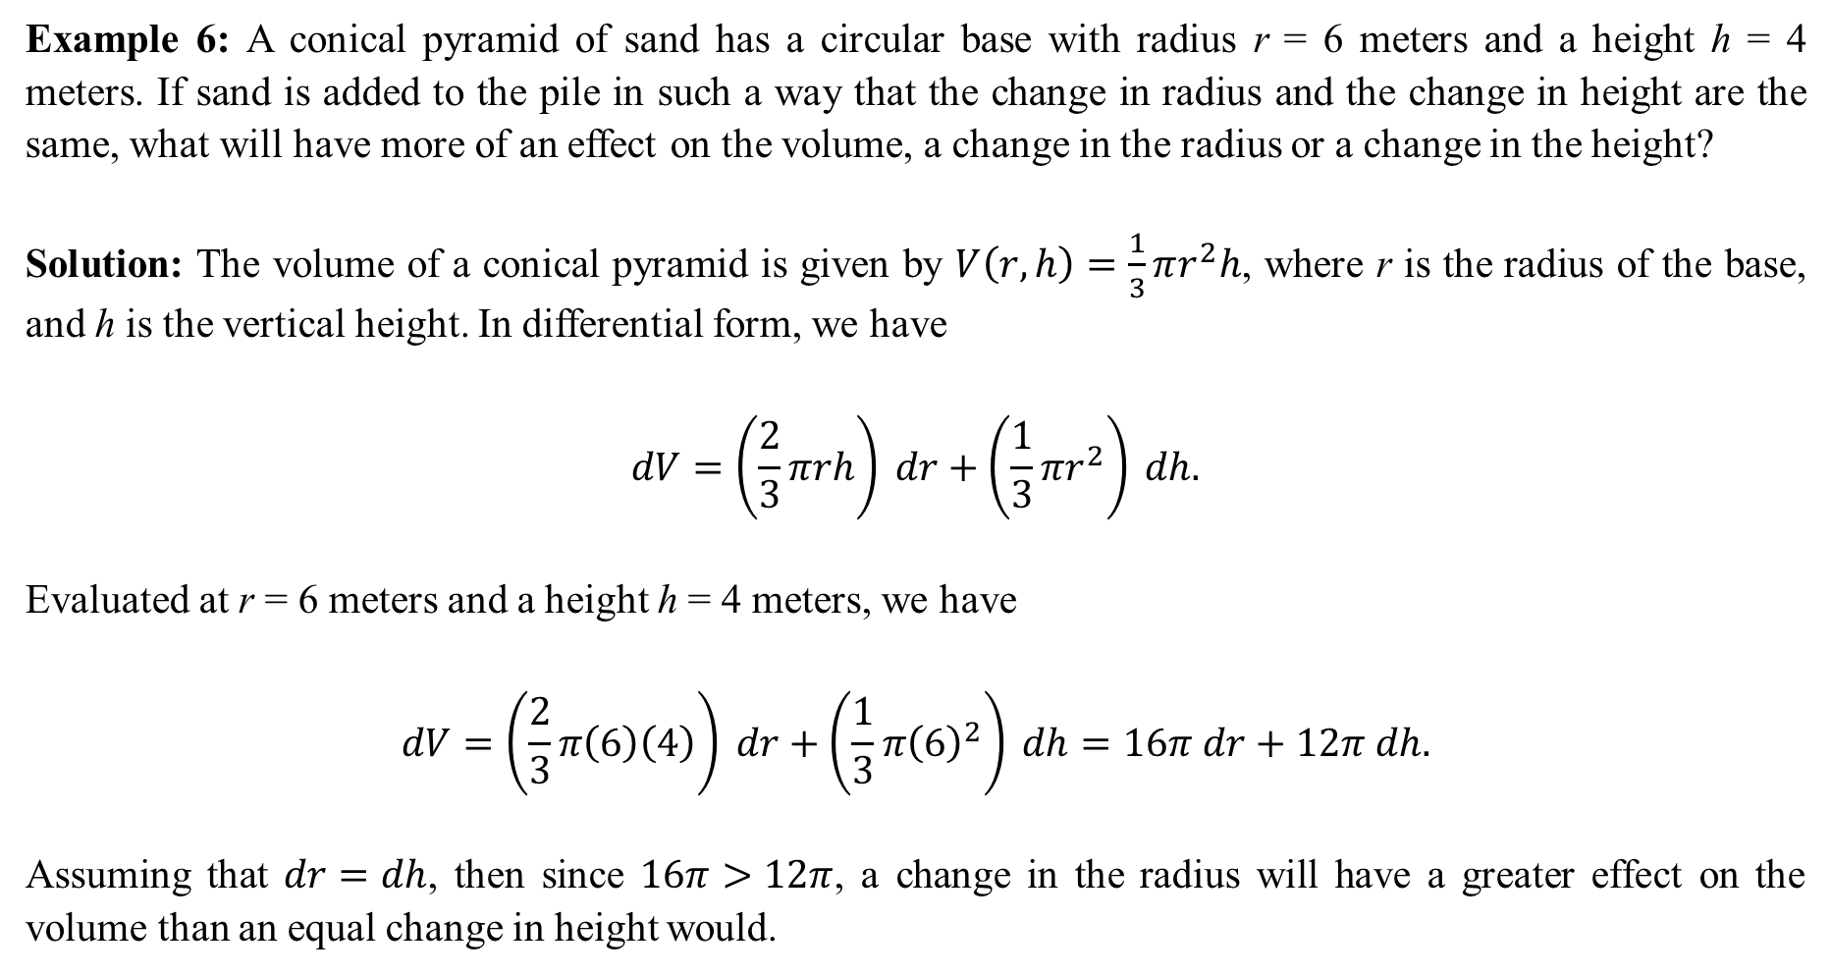
Example 6: A conical pyramid of sand has a circular base with radius r = 6 meters and a height h = 4 meters. If sand is added to the pile in such a way that the change in radius and the change in height are the same, what will have more of an effect on the volume, a change in the radius or a change in the height?
Solution: The volume of a conical pyramid is given by $V\left(r,h\right)=\frac{1}{3}πr^{2}h$, where r is the radius of the base, and h is the vertical height. In differential form, we have
$$dV=\left(\frac{2}{3}πrh\right) dr+\left(\frac{1}{3}{πr}^{2}\right) dh.$$
Evaluated at r = 6 meters and a height h = 4 meters, we have
$$dV=\left(\frac{2}{3}π\left(6\right)\left(4\right)\right) dr+\left(\frac{1}{3}π{\left(6\right)}^{2}\right) dh=16π dr+12π dh.$$
Assuming that $dr=dh$, then since $16π>12π$, a change in the radius will have a greater effect on the volume than an equal change in height would.

Slide 11
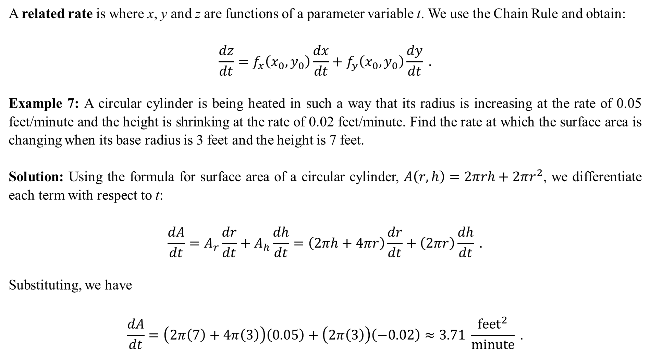
A related rate is where x, y and z are functions of a parameter variable t. We use the Chain Rule and obtain:
$$\frac{dz}{dt}=f_{x}\left(x_{0},y_{0}\right)\frac{dx}{dt}+f_{y}\left(x_{0},y_{0}\right)\frac{dy}{dt} .$$
Example 7: A circular cylinder is being heated in such a way that its radius is increasing at the rate of 0.05 feet/minute and the height is shrinking at the rate of 0.02 feet/minute. Find the rate at which the surface area is changing when its base radius is 3 feet and the height is 7 feet.
Solution: Using the formula for surface area of a circular cylinder, $A\left(r,h\right)=2πrh+2πr^{2}$, we differentiate each term with respect to t:
$$\frac{dA}{dt}=A_{r}\frac{dr}{dt}+A_{h}\frac{dh}{dt}=\left(2πh+4πr\right)\frac{dr}{dt}+\left(2πr\right)\frac{dh}{dt} .$$
Substituting, we have
$$\frac{dA}{dt}=\left(2π\left(7\right)+4π\left(3\right)\right)\left(0.05\right)+\left(2π\left(3\right)\right)\left(−0.02\right)≈3.71 \frac{{feet}^{2}}{minute} .$$

