Slide 1
MAT267: Vectors
Scott Surgent

Slide 2
For purposes of applications in calculus and physics, a vector has both a direction and a magnitude (length) and is usually represented by an arrow. The start of the arrow is the vector’s foot, and the end is its head. A vector is usually labelled in boldface, such as v.
In an xy-axis system ($R^{2}$), a vector is written $v=〈v_{1}, v_{2}〉$, which means that from the foot of v, move $v_{1}$ units in the x direction, and $v_{2}$ units in the y direction, to arrive at the vector’s head. The values $v_{1}$ and $v_{2}$ are the vector’s components. In $R^{3}$, a vector has three components and is written $v=〈v_{1}, v_{2}, v_{3}〉$.

Slide 3
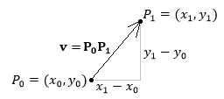
Given two points, $P_{0}=(x_{0}, y_{0})$ and $P_{1}=(x_{1}, y_{1})$ in $R^{2}$, a vector $P_{0}P_{1}$ can be drawn with its foot at $P_{0}$ and head at $P_{1}$, where $P_{0}P_{1}=〈x_{1}−x_{0},y_{1}−y_{0}〉.$ In $R^{3}$, the vector is expressed
$P_{0}P_{1}=〈x_{1}−x_{0},y_{1}−y_{0},z_{1}−z_{0}〉$.
A scalar is a number only, with no implied direction. Scalars are chosen from the set of real numbers R.
The magnitude of a vector $v$ is found by the Pythagorean Formula:
$$\left|v\right|=\sqrt{v_{1}^{2}+v_{2}^{2}} \left(in R^{2}\right)$$
or $\sqrt{v_{1}^{2}+v_{2}^{2}+v_{3}^{2}} (in R^{3})$.
The notation $\left|v\right|$ is the magnitude of v and is always a non-negative value. The expression $\left|v\right|$ is a scalar.

Slide 4
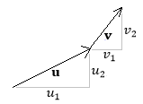
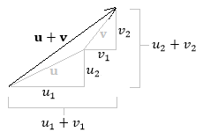
To add two vectors $u=〈u_{1}, u_{2}〉$ and $v=〈v_{1}, v_{2}〉$, add the respective components:
$$u+v=〈u_{1}+v_{1},u_{2}+v_{2}〉.$$
Place the foot of v at the head of u, then sketch a vector that begins at the foot of u and ends at the head of v. The vector $u+v$ is called the resultant.
Pay attention to notation. Parentheses are used to represent points, and angled brackets are used to represent vectors.

Slide 5
A vector may be multiplied by any real number c, called a scalar multiple.
For example, if u is a vector, then $2u=u+u=〈2u_{1},2u_{2}〉$, which results in a vector 2u that is twice the magnitude of u.
Scalars act as coefficients when multiplied to a vector.
In general, for a vector v and a scalar c, the magnitude of cv is $\left|cv\right|=\left|c\right|\left|v\right|$, where $\left|c\right|$ is the absolute value of c.
Two non-zero vectors u and v are parallel if one can be written as a scalar multiple of the other, $u=cv$ for some non-zero scalar c.

Slide 6
There are two closure properties of vectors:
C1. If u and v are two vectors in $R^{2}$ (or $R^{3}$), then their vector sum u + v is also in $R^{2}$ (or $R^{3}$).
C2. If u is a vector in $R^{2}$ (or $R^{3}$), then for any scalar c, its scalar multiple cu is also in $R^{2}$ (or $R^{3}$).

Slide 7
The structural properties of vectors are:
P1. Commutativity: u + v = v + u. Vectors can be added in any order.
P2. Associativity: (u + v) + w = u + (v + w).
P3. Additive Identity: $0=〈0,0〉$ or $〈0,0,0〉$, with the property that u + 0 = 0 + u = u. Thus, 0 is called the zero vector, and is a single point, with a magnitude of 0: $\left|0\right|=0$, and if $\left|v\right|=0$, then v = 0.
P4. Additive Inverse: For any non-zero vector u, the vector $−u$ exists with the property that $u+\left(−u\right)=0$. Visually, $−u$ has the same magnitude as $u$, but points in the opposite direction. Subtraction of two vectors is now defined: $u−v=u+\left(−v\right)=u+(−1v)$.

Slide 8
Structural Properties, continued:
P5. Distributivity of a scalar across vectors: If c is a scalar, then $c\left(u+v\right)=cu+cv$.
P6. Distributivity of a vector across scalars: If c and d are scalars, then $\left(c+d\right)u=cu+du$.
P7. Associativity and Commutativity of Scalars: $cdu=c\left(du\right)=\left(cd\right)u=d\left(cu\right)=dcu$.
P8. Multiplicative scalar identity: 1v = v.

Slide 9
Any set $V$ for which the two closure properties and the eight structural properties are true for all elements in $V$ and for all real-number scalars is called a vector space.
Elements of a vector space are called vectors.
Common vector spaces are $R^{n}$, where n is any non-negative integer.
The xy-axis system $R^{2}$ is a vector space, where any ordered pair (a,b) can be thought of as a vector from (0,0) to (a,b). In this manner, the elements of $R^{2}$ are vectors of the form $〈a,b〉$, and all of the closure and structural properties listed above are met.
Similarly, for $R^{3}$, the real line $R^{1} (=R)$, and the trivial space $R^{0}=0$ are vector spaces.

Slide 10
Given any non-zero vector v, the unit vector of v is found by multiplying v by $\frac{1}{\left|v\right|}$.
The unit vector has magnitude 1. That is, $\left|\frac{v}{\left|v\right|}\right|=\frac{1}{\left|v\right|}\left|v\right|=1$.
The unit vector of v is any vector of length 1 parallel and in the same direction to v. Common notation for the unit vector of v is $\hat{v}$ (“v-hat”) or $v_{unit}$.
In $R^{2}$, the vectors $i=〈1,0〉$ and $j=〈0,1〉$ are called the standard orthonormal basis vectors, which allows us to write a vector $v=〈v_{1}, v_{2}〉=v_{1}i+v_{2}j$.
In $R^{3}$, the standard orthonormal basis vectors are $i=〈1,0,0〉$, $j=〈0,1,0〉$ and $k=〈0,0,1〉$. The notation $〈v_{1}, v_{2}〉$ and $v_{1}i+v_{2}j$ to represent a vector in $R^{2}$ can be used interchangeably.

Slide 11
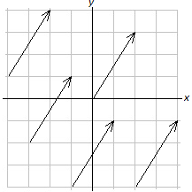
Example 1: Sketch $u=〈2,3〉=2i+3j$.
Solution: From any starting point, move 2 units in the x (horizontal) direction, and 3 units in the y (vertical) direction. Below are five copies of the vector u.
The foot can be placed anywhere. Multiple copies of the same vector can be drawn using different starting points. The position of a vector relative to a coordinate axis system is not relevant. As long as its direction and magnitude are not changed, it is considered to be the same vector.

Slide 12
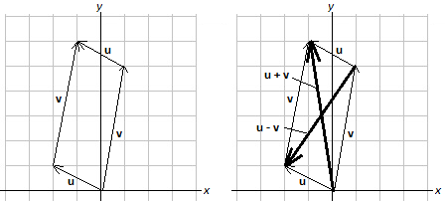
Example 2: Given $v=〈4,−5〉$, find $\left|v\right|$, and the unit vector of v.
Solution: The magnitude of v is
$\left|v\right|=\sqrt{{\left(4\right)}^{2}+{\left(−5\right)}^{2}}=\sqrt{16+25}=\sqrt{41}$.
The unit vector of v is
$\hat{v}=v_{unit}=\frac{1}{\sqrt{41}}〈4,−5〉=\left\langle \frac{4}{\sqrt{41}},−\frac{5}{\sqrt{41}}\right\rangle$.
Example 3. Given $u=〈−2,1〉$ and $v=〈1,5〉$, Find and sketch (a) u + v, and (b) u – v.
Solution: We have
$u+v=〈−2+1,1+5〉=〈−1,6〉$
$u−v=〈−2−1,1−5〉=〈−3,−4〉$.

Slide 13
Example 4: Given the vectors $u=〈1,−4,2〉$ and $v=〈−5,8,3〉$, find w where 3w + 2u = –v.
Solution: Using algebra, solve for w:
$$3w+2u=−v$$
$$3w=−v−2u$$
$$w=−\frac{1}{3}v−\frac{2}{3}u.$$
Now, substitute u and v, and simplify:
$$w=−\frac{1}{3}v−\frac{2}{3}u$$
$$=−\frac{1}{3}〈−5,8,3〉−\frac{2}{3}〈1,−4,2〉$$
$$=\left\langle \frac{5}{3}, −\frac{8}{3},−1\right\rangle +\left\langle −\frac{2}{3},\frac{8}{3},−\frac{4}{3}\right\rangle$$
$$=\left\langle 1,0,−\frac{7}{3}\right\rangle .$$

Slide 14
Example 5: Given $v=〈−1,5,2〉$, find a vector w in the same direction as $v$, with magnitude 3.
Solution: The unit vector is $v_{unit}=\frac{1}{\sqrt{30}}〈−1,5,2〉.$ Then multiply by 3:
$$w=3v_{unit}=\frac{3}{\sqrt{30}}〈−1,5,2〉.$$

Slide 15
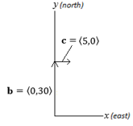
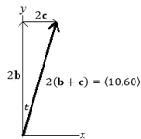
Example 6: A boat travels north at 30 miles per hour. Meanwhile, the current is moving toward the east at 5 miles per hour. If the boat’s captain does not account for the current, the boat will drift to the east of its intended destination. After two hours, find (a) the boat’s position as a vector, (b) the distance the boat travelled, and (c) the boat’s position as a bearing.
Solution. Superimpose an xy-axis system, so that the positive y-axis North, and the positive x-axis is East. Thus, the boat’s vector can be represented by $b=〈0,30〉$, and the current’s vector by $c=〈5,0〉$.
The boat’s position after two hours will be $2\left(b+c\right)=2〈5,30〉=〈10,60〉$. From the boat’s starting point, the boat moved 10 miles east and 60 miles north.

Slide 16
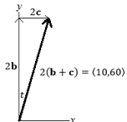
b) The boat travelled a distance of $\left|2(b+c)\right|=2\sqrt{5^{2}+{30}^{2}}=2\sqrt{925}$, or about 60.83 miles.
c) Viewing a drawing below, we see that we can find the angle $t$ using inverse trigonometry. Thus, $t=\tan^{−1}\left({10}/{60}\right)≈9.46$ degrees East of North.

Slide 17
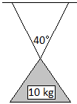
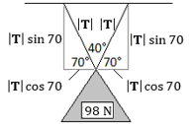
Example 7: A 10 kg mass hangs by two symmetric cables from a ceiling such that the cables meet at a 40-degree angle at the mass itself. Find the tension (in Newtons) on each cable.
Solution: The force of the mass with respect to gravity is
$F=ma=\left(10 kg\right)\left(9.8\frac{m}{s^{2}}\right)=98 N$.
Let $\left|T\right|$ be the tension on one cable. We decompose $\left|T\right|$ into its vertical and horizontal components:

Slide 18
Each cable has a tension of about 52.14 N. If the angle at which the cables meet was larger, the tensions would be greater. For example, if the cables were to meet at the mass at an angle of 150 degrees, then each cable would have a tension of
$$\left|T\right|=\frac{98}{2\sin{15}}=189.32 N$$
The two horizontal components sum to 0, since the forces cancel one another, while the two vertical components support the 98 N downward force. Thus, we have
$$2\left|T\right|\sin{70}=98.$$
Solving for $\left|T\right|$ we, we obtain $\left|T\right|=\frac{98}{2\sin{70}}=52.14 N.$

